Slide 2
Augmented Reality: What It Can and Cannot Do
Wednesday, August 14, 2019

Slide 3
Panelists
Jeff Cowgill, Jr. Marxent Labs
Dr. Kelly Hale
Design Interactive, Inc.
Dr. Paul Havig
Air Force Laboratory
Ken Mayer
Ford Motor Company
Dr. So Young Kim
NASA JPL
Moderator: Rebecca Grier
Ford Motor Company

Slide 4
Augmented Reality: What it can and cannot do for retailers
Jeff Cowgill
Director of Software Development
Notes:
Bio introduction?
Research background in VR.

Slide 5
about Marxent
what we do and why we do what we do

Slide 6
Our mission is to make it fast and easy for everyone to design, visualize and buy complex purchases.
Focus on AR, VR, and Web applications
CLIENTS
AWARDS

Slide 7
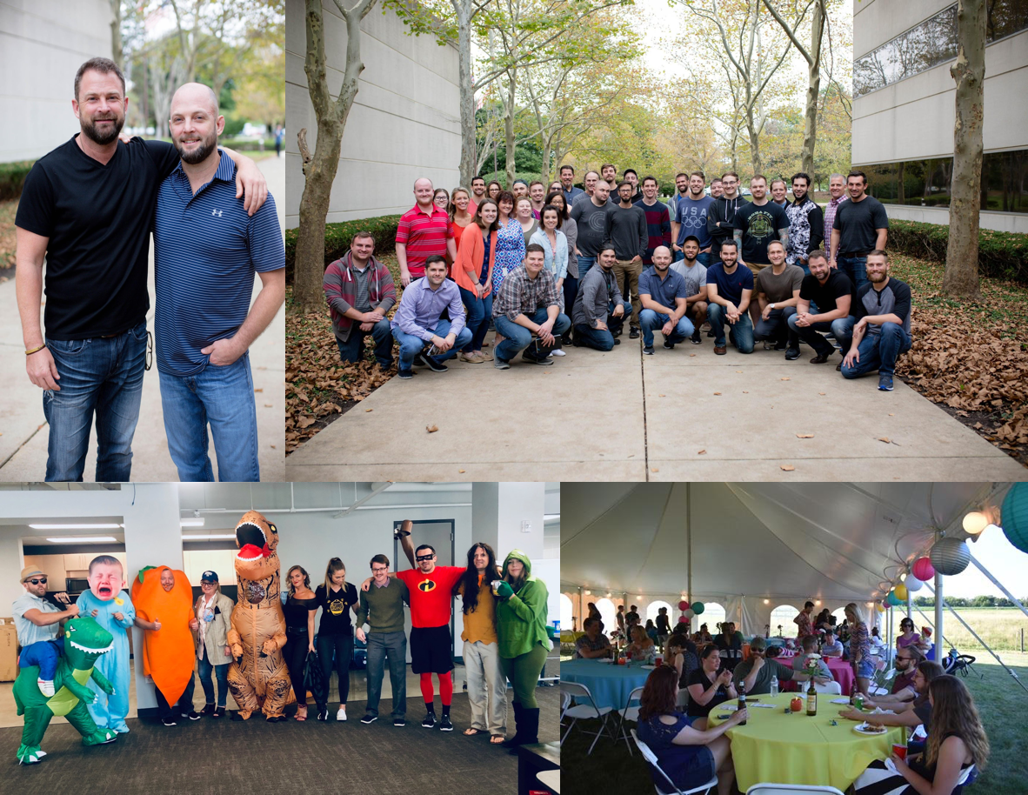
Founded in 2011 by Barry and Beck Besecker
Offices located in Miamisburg, OH, St Petersburg, FL, and London, UK
70 person team
Notes:
Talk about our culture and building a startup in Dayton Ohio
Mention Detroit Ventures (Dan Gilbert)
Mention our expansion into Europe with John Lewis Partners and ECI

Slide 8
augmented reality in retail
AR is providing real ROI to retail companies now
Notes:
Simple Section Header Construction Notes: always lower case for titles, when using a subheader, use bold for emphasis

Slide 9
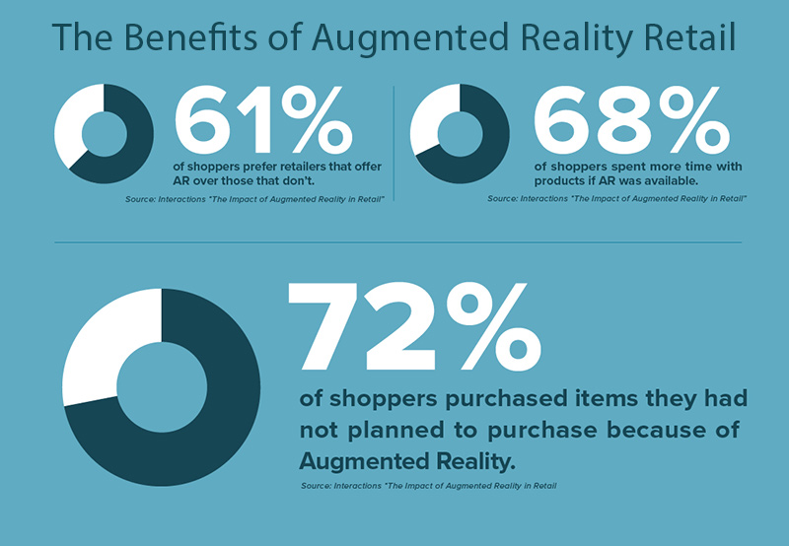
Retailers invest in AR to:
Engage customers
Visualize purchases in context
Improve customer satisfaction and reduce returns
Personalize the shopping experience
Provide self-service store navigation
Create content for social media
Notes:
Hygiene for makeup or clothes and shoes

Slide 10
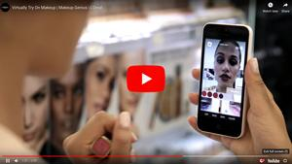
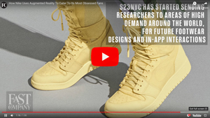
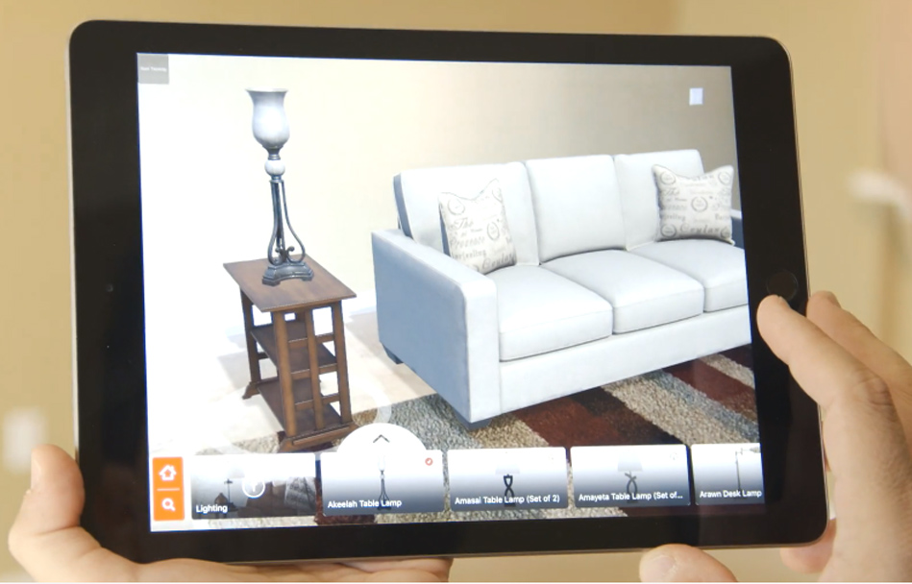
Examples of AR in retail applications
The L’Oreal Makeup Genius app lets customers try on makeup, blend different shades on their faces, and mix products to get the results they want. By scanning the product’s barcode in a store or selecting the product online, the app will apply it to the customer’s face using Augmented Reality. L’Oreal owns Modiface, the company behind Sephora’s Virtual Artist app.
Designed by a special office located in Manhattan called S23NYC (a reference to Michael Jordan’s number), the Nike SNKRS app is an experimental project that has been aimed at engaging with the quintessential sneaker collector, or what Fast Company refers to as “obsessed superfans.” The app uses a combination of exclusive promotions, geofencing and Augmented Reality to help fans unlock rare sneakers
Macy’s uses a 3D Cloud-based Augmented Reality API to make 3D AR furniture available in their native Macy’s iOS and Android apps. Consumers shopping for furniture using the Macy’s native iOS app simply tap the “View In My Room” button on the product detail page of the furniture that they’re interested in visualizing. This launches the AR camera feature and allows them to place the 3D furniture into the context of their own homes.
Notes:
https://www.marxentlabs.com/ar-in-retail-top-augmented-reality-retail-apps-guide/

Slide 11
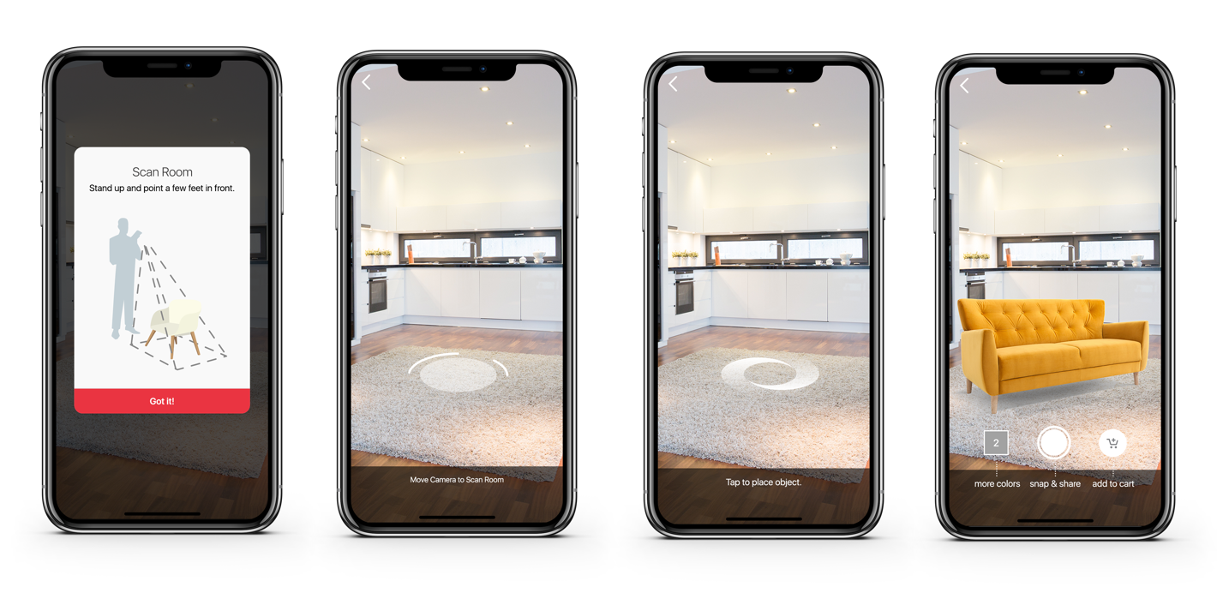
The Marxent AR SDK
Simple SDK integration ● Proprietary MXT tracking + ARKit/ARCore ● Physically-based rendering
Notes:
Features:
Powered by the 3D Cloud CMS
MXT tracking gives up to 7 second improvement in initialization

Slide 12
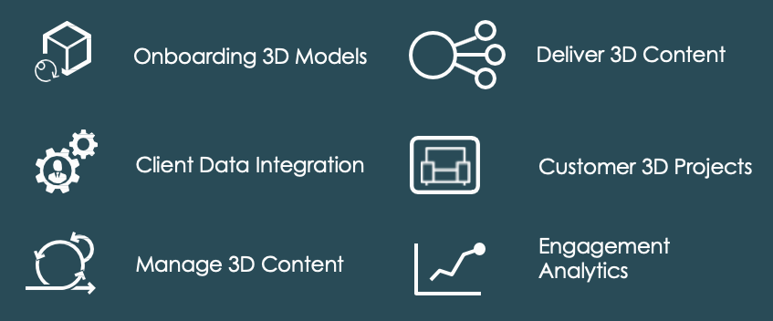
Notes:
TODO Need to clean this slide up visually
Talk about:
Our enterprise platform to power the content needed in AR applications
We provide omni channel solutions that allow for a 3D model and it’s associated meta data to be used in AR, Web, Mobile, and VR
We also support complex configurable products that can have swapping parts, swapping finishes, and business rules

Slide 13
Augmented Reality ROI
2x
25%
50%+
increase in conversion
increase in average order value
usage when AR is an available option
Notes:
The Marxent AR SDK is providing proven ROI to our partners, integrated into their eCommerce mobile applications.
Source: Marxent clients 2019
Conversion = eCommerce Checkout
Average Order Value = increase in cart transaction vs non-AR cart transaction
Usage = when AR is an option over 50% of people use AR

Slide 14
What we can’t do yet and what AR is not good for.
Feeling products (fabric softness, metal smoothness, etc.)
Need haptics
Color matching (dependent on device)
Need improved devices
Immersing the user in an entirely different space (replacing, not just augmenting)
VR and the Marxent 3D Roomplanner
Complex interactions with real-world objects
Need advances in AR algorithms and cameras
Small inexpensive products with lower volumes, too expensive to create 3D models
Need to reduce the cost of high quality models

Slide 15
Panelists
Dr. Kelly Hale
Design Interactive, Inc.

Slide 16
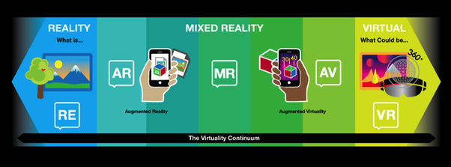
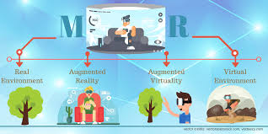
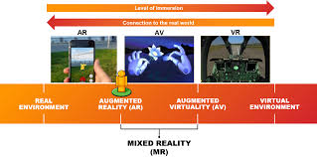
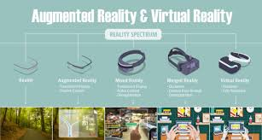
Milgram & Kishino, 1994
http://www.surroundtech.com/blog/what-are-smart-glasses-and-how-are-they-used-in-business
http://www.ayzenberg.com/news/holographic-moments-5/
https://www.yantraas.com/mixed-reality/
https://www.accenture.com/gb-en/blogs/blogs-immersive-experience-wave-learning-ropes
https://www.dreamstime.com/augmented-reality-visualization-device-character-concept-furniture-application-to-build-interior-catalog-shop-image124190962
Kelly Hale, 2019
Notes:
AR and VR are different – diferent goals; not necessarily a continuum of use, but has been visualized this way – Milgram’s Mixed Reality Spectrum
Do share some aspects – 3D objects within space; more immersive = ‘more like VR’

Slide 17
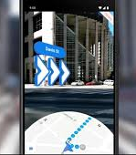
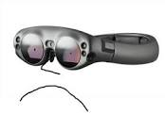
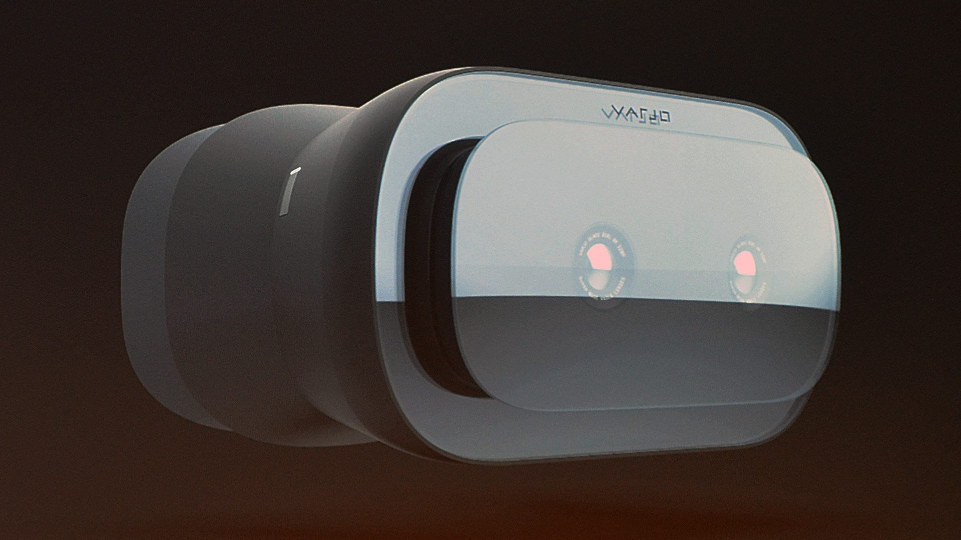
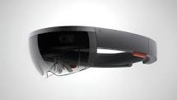
Primary focus on Visual Augmentation
Mobile Solutions (e.g., Pokemon Go)
Visually place virtual assets
Interactions are limited to 2D touch gestures on your device
Audio enhancements
Headset Solutions
Limited gesture interaction
Some hand and finger tracking capabilities
Kelly Hale, 2019

Slide 18
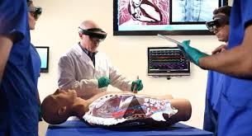
Applications
Opportunity to interact with the world and fully engage haptically – but how?
Guiding cues in the field of view (navigational cues; Google maps)
Hands on learning in a spatially aware context (maintenance; medical; battlefield mission planning)
Replicating the touch/feel/response of objects
Ergonomics related to sustained postures
http://internetmedicine.com/augmented-reality/
https://www.diorama.com/2018/12/03/tactical-augmented-reality-microsofts-hololens-headsets-for-battlefield-480-million/
https://www.army.mil/article/218583/army_developing_training_to_expand_medical_capabilities

Slide 19
AR and haptics
CUTANEOUS
2D form and 3D form
Impact force
KINESTHETIC
Body orientation (torso, limbs, head)
Position in egocentric space
PROPRIOCEPTION
SENSORY SYSTEM
Cognitive Associative Autonomous
MOTOR LEARNING STAGES (Fitts & Posner, 1967)
Kelly Hale, 2019

Slide 20
Challenges and Opportunities
AR systems are advancing rapidly, and being targeted for impacting training in egocentric space
Haptics systems are on the rise and offering more advanced interactions, yet 3D gesturing and interaction are challenging to replicate
Need a strategic roadmap to drive appropriate, meaningful, cost-effective haptics interactions to AR solutions that optimize learning and training transfer with operational impact
Ergonomics of sustained postures
Training hands on physical interactions – spatial accuracy; fine motor tasks
Aliprantis, et al., 2019
Kelly Hale, 2019

Slide 21
Experiences at Wright-Patterson Air Force Base
Dr. Paul Havig
Air Force Laboratory
Technology has been available and utilized for several years however:
Usage has been cost-prohibitive
Experience and results have been less than optimal
With reductions in price point, we have the chance (and the responsibility) to implement correctly
Be careful with technology – don’t move beyond enablement to impediment!

Slide 22
Consumer AR Exploration
Screen Based
TV
Sports – SMT.com sports AR
Phone/Tablet
Sports – MLB Ballparks App
Household –
Ikea – AR furniture placement tool (2017)
Houzz – AR Kit (2017)
Glasses Based
Training/Industrial
Google Glass
Microsoft HoloLens
Magic Leap
Sports
Solos/Everysight Raptor – cycling based
Ken Mayer
Ford Motor Company

Slide 23
Automotive
Use Cases
Navigation and Wayfinding
Driver Assistance Technology
Expectation Vs Reality
Field of View/Packaging
Data management
Timeline
Are glasses going to be the next big thing and built in AR is a fail?

Slide 24
Field of View and Limitations

Slide 25
Stories from NASA JPL
How ProtoSpace has been used in designing spacecraft for JPL missions
AR procedure research on assembly of the instrument components.
Limitations and Challenges - viewer vs doer.
Dr. So Young Kim
NASA JPL

Slide 26
Q&A

